Slide 1
GlycoSeq
Glycopeptide editing window

Slide 2
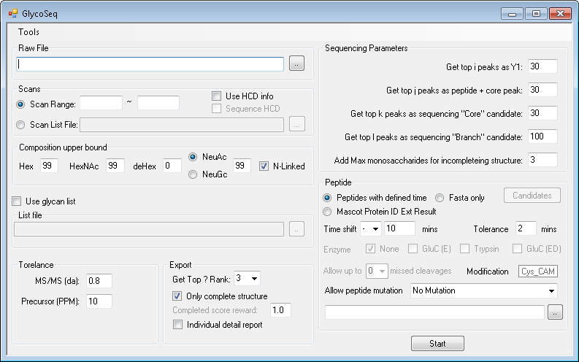
New GlycoSeq
1. Select file type
Note: “Mascot Protein ID Ext” option only accept export file by MascotProteinIDExtractor 1.1
Download Link: https://iu.box.com/s/cp258sftzoapzyymdrt0gejnetrjkorx

Slide 3
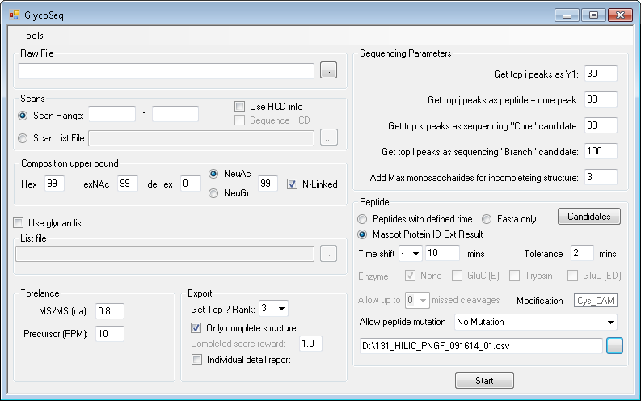
2. Select file

Slide 4
3. View candidates

Slide 5
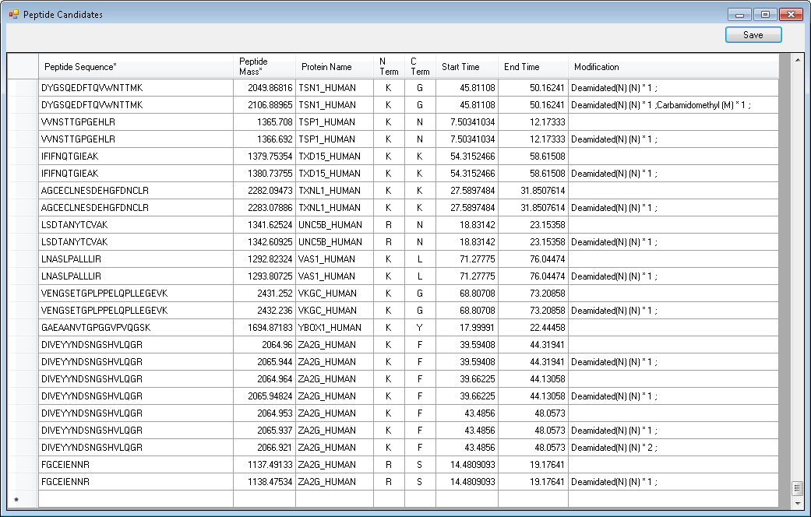
Peptide candidates
Save list
Click here and press “delete” to delete
Double click empty cell to add new candidate (sequence and mass is required)

Slide 6
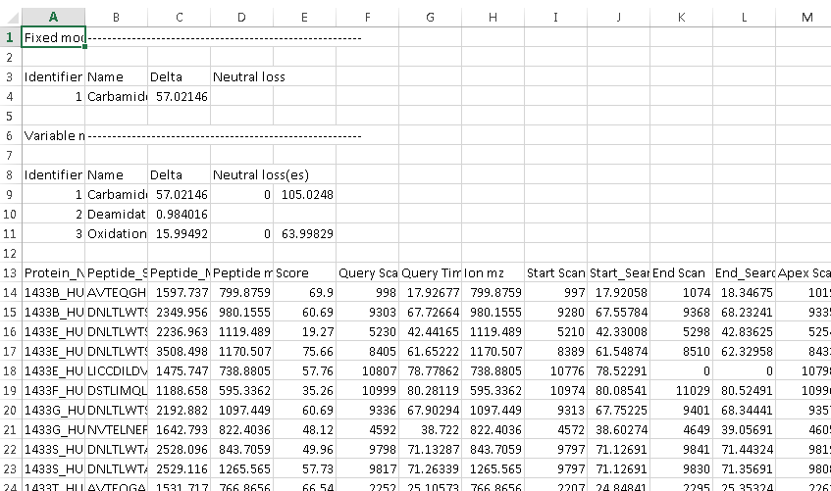
MascotProteinIDExtractor 1.1
Add modification table in export file
Download Link: https://iu.box.com/s/i3ogm247bajt29aku7v5yweegqtgb78h

